Slide 1


St. Peter’s CATHOLIC PRIMARY SCHOOL

Slide 2
Our Voice
We use a wide range of creative strategies for moving learning into action, faith in action; We develop our advocacy skills for change for those in the greatest need in society.
Building the Kingdom has given us ownership of our faith. It enables us to be stewards of the earth and activists of faith. Every child in our school knows that they are empowered to make a difference not only to their own lives but to the lives of others locally, nationally and internationally
At St Peter’s, we are very proud to be a part of the Building the Kingdom programme where we are striving to transform our world. Through Building the Kingdom, we explore the big questions of purpose and meaning that arise throughout the Liturgical year

Slide 3


Slide 4
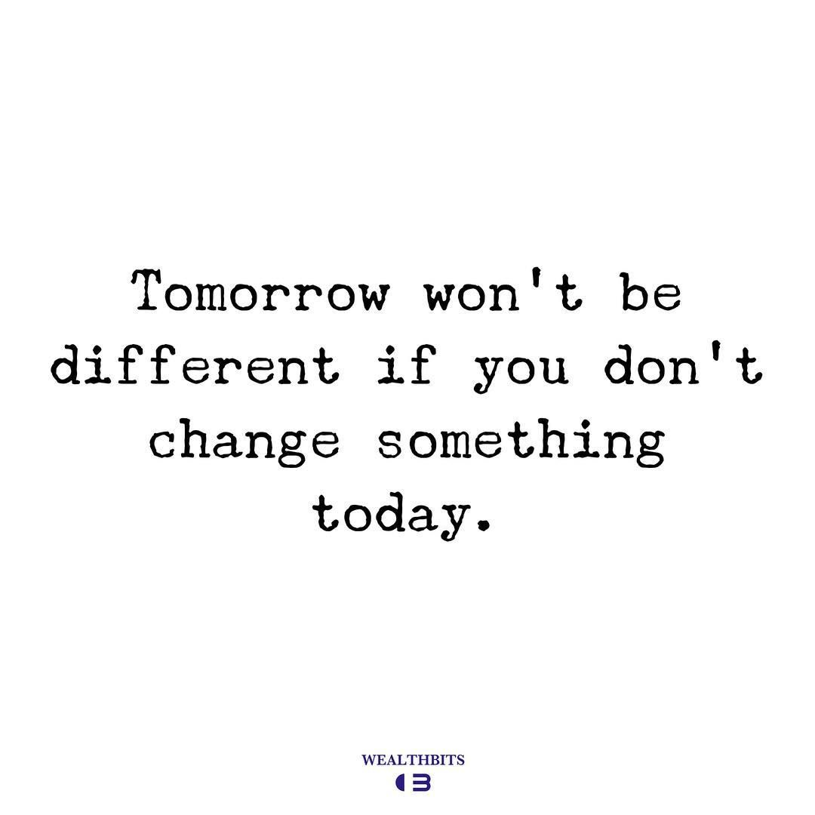

Slide 5


Slide 6
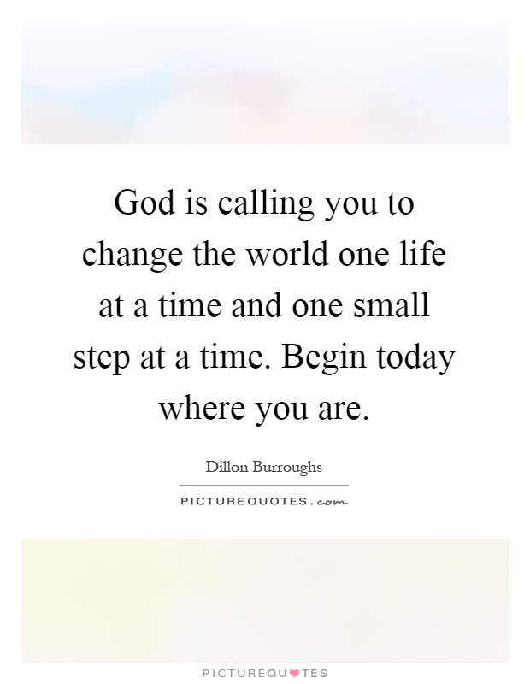

Slide 7
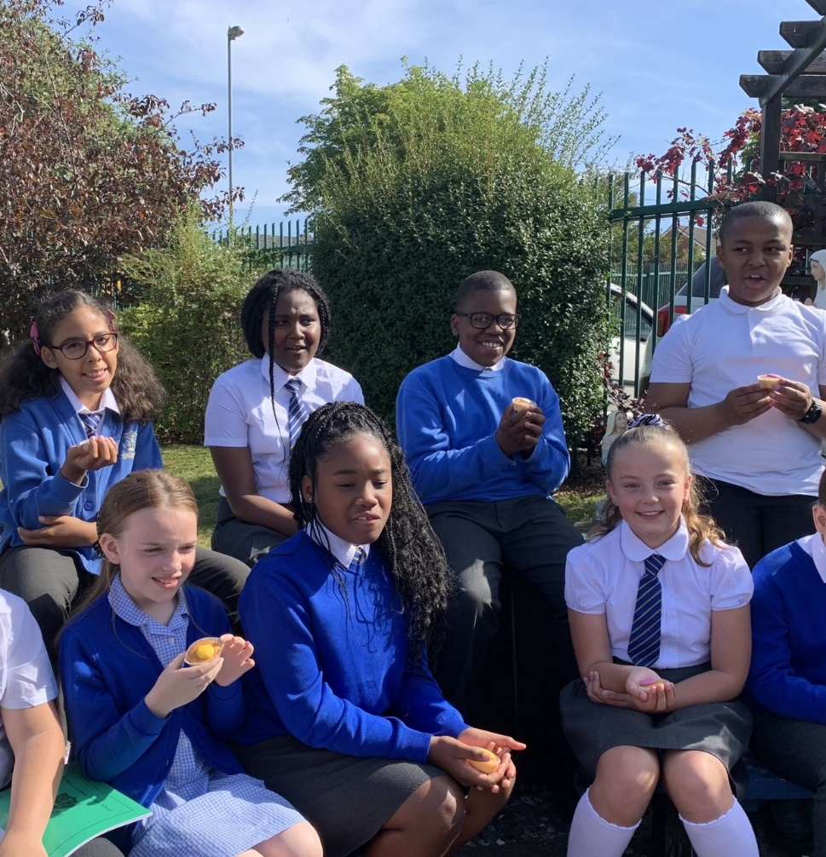
Mary’s Birthday
Key Stages work on a tribute to Our Lady’s birthday in September.
Each year group looked at Mary from a different perspective, for example, Mary as a mother and Mary as a refugee in Egypt. The early years thought carefully about their families. The children took time to appreciate what their mother figures do for them.
They drew hearts for the women in their lives, thanking them.
Year Four undertook a project about Mary as a refugee. The children researched modern day refugees incorporating geography, history and RE. Everyone has learned so much about Our Lady’s unconditional love for God and about her many life challenges. Every child wants to be more like Mary.
The whole school visited the prayer garden

Slide 8
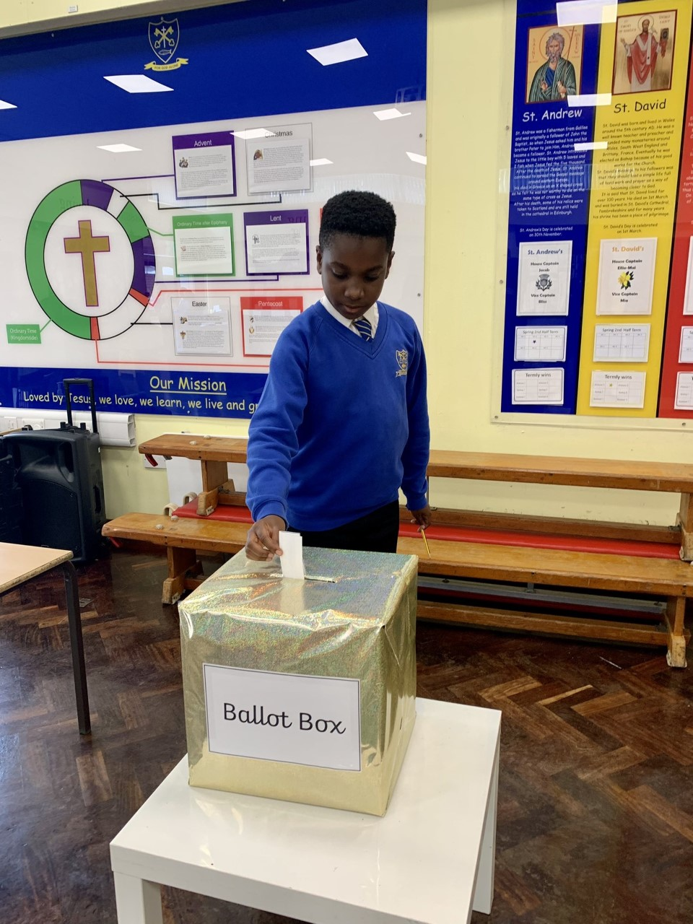
Rights and responsibilities
Every Human being, regardless of background or circumstances has equal rights as a person because they are made in the image and likeness of god.
We took to the polling station to vote in our new committee members for the year.

Slide 9
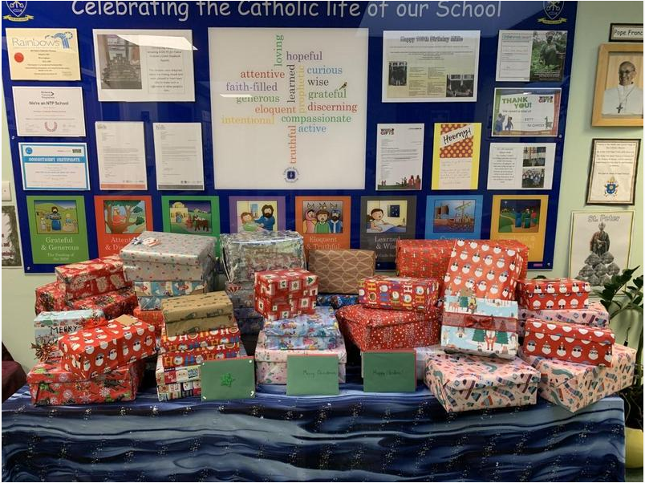
Option for the poor and vulnerable
When we heard about Migrant Help UK's Christmas shoebox appeal, we knew we had to get involved. we donated over fifty shoeboxes packed full of gifts for refugee and asylum-seeking children.
The volunteers at Migrant Help UK were bowled over by the generosity shown by our school community and were very grateful for each and every shoebox that was put together with such care.

Slide 10
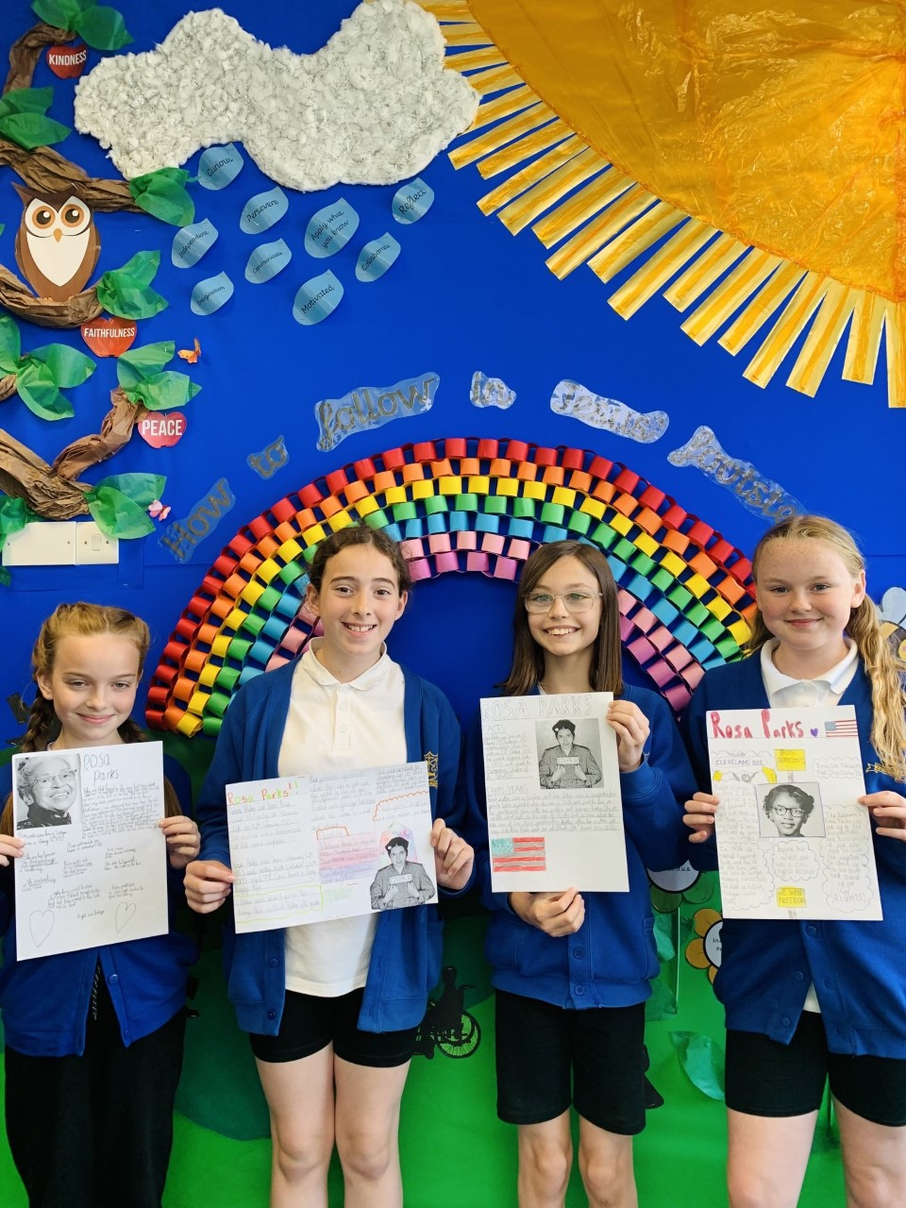
Activist in faith
We are activists in our faith by following the example of various inspirational peers. We looked at modern day activists who have made a big difference to our world. We researched Malala Yousafzai, Greta Thunberg and rosa parks, to name but a few.
Year Six learned a lot from their Kingdom of God project which focussed on how they can show the qualities Jesus taught us. The class studied Rosa Parks

Slide 11
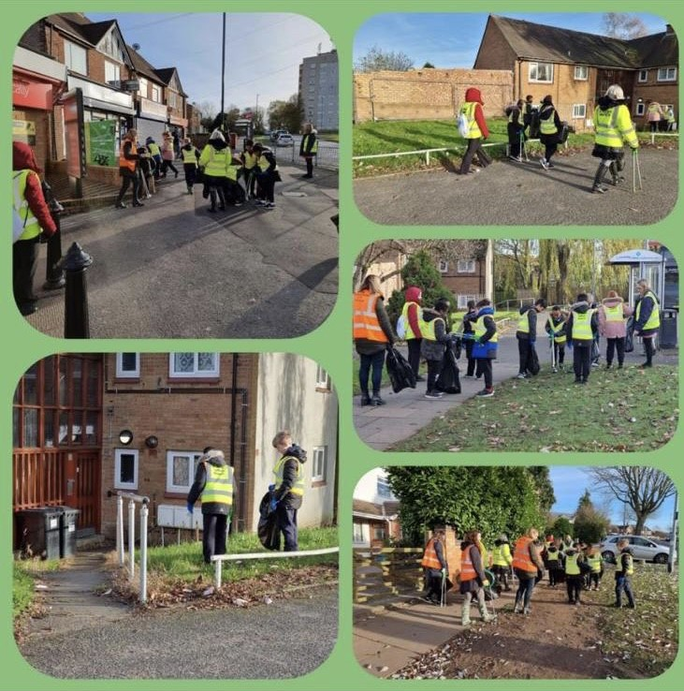
Stewards of the Earth
Year 4 wrote to the local mp to share their upset at the state of the local area. What an interesting way of learning about Catholic Social Teaching and Pope Francis’ Laudato Si (care for our common home). Year 4 were invited litter picking with the team.

Slide 12
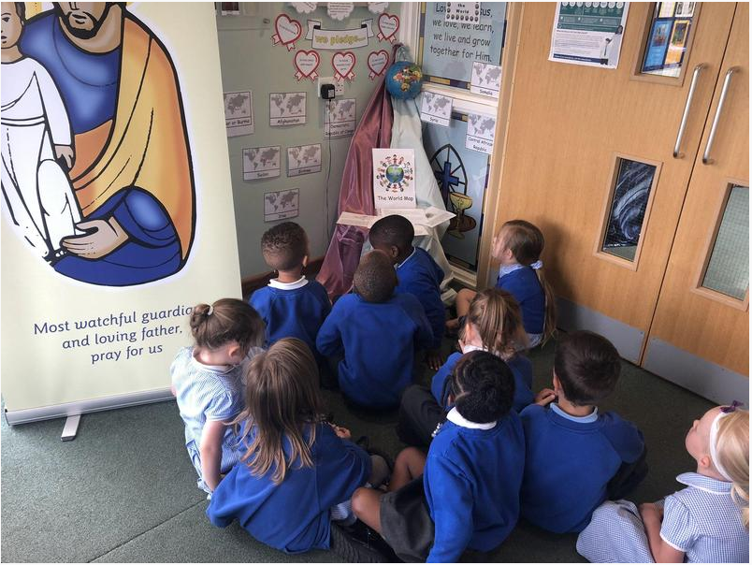
Dignity of the human person
As part of our work for Refugee Week in June 2021, we created a pilgrimage with the different 'stations' of a refugee's journey.
First, the children put themselves in a refugee's shoes and tried to imagine what they would pack if they were forced to flee their home at short notice. Then they imagined the emotional goodbyes as they began their long journey.
At the third station, the children tried to imagine the long walk, often across deserts, mountains and forests in search of a place of safety. Next, the children paused for a moment to try to imagine having to spend time in refugee camps. The children were shocked to learn that some refugees wait years before being granted asylum. After this, the children thought about a refugee's final journey to their new home. They talked about how a refugee must have very mixed emotions ranging from relief and excitement to nervousness and anxiety. The last station symbolised a new home. Here, children discussed what it must be like to arrive in a foreign land with a new language and culture.

Slide 13
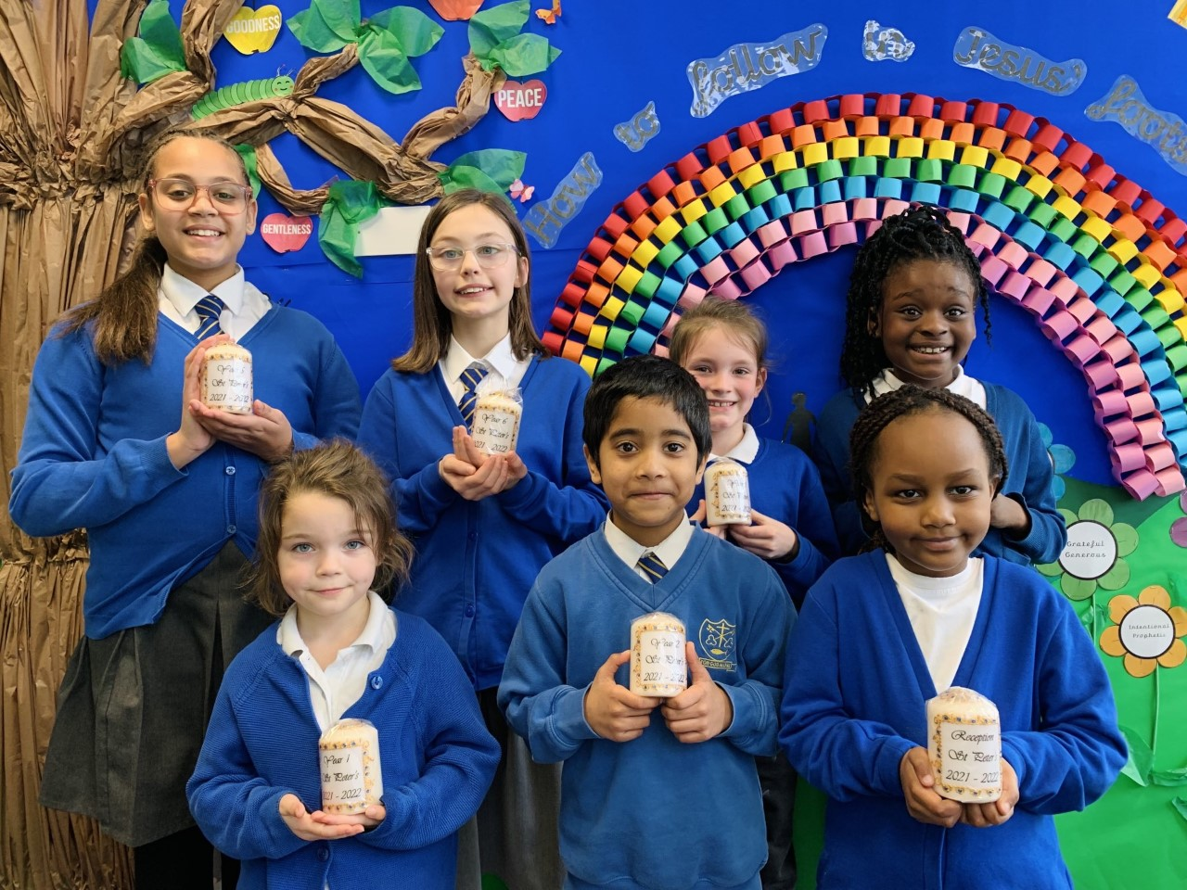
Candlemas
To celebrate Candlemas, we’ve had some beautiful candles made! We will light these candles during prayer services and will take them along to mass too!

Slide 14

School of sanctuary
We are proud to announce that we achieved the Schools of Sanctuary Award in January 2022 but this it not the end! We will continue our work on refugee and asylum seekers as well as supporting Schools of Sanctuary.

Slide 15
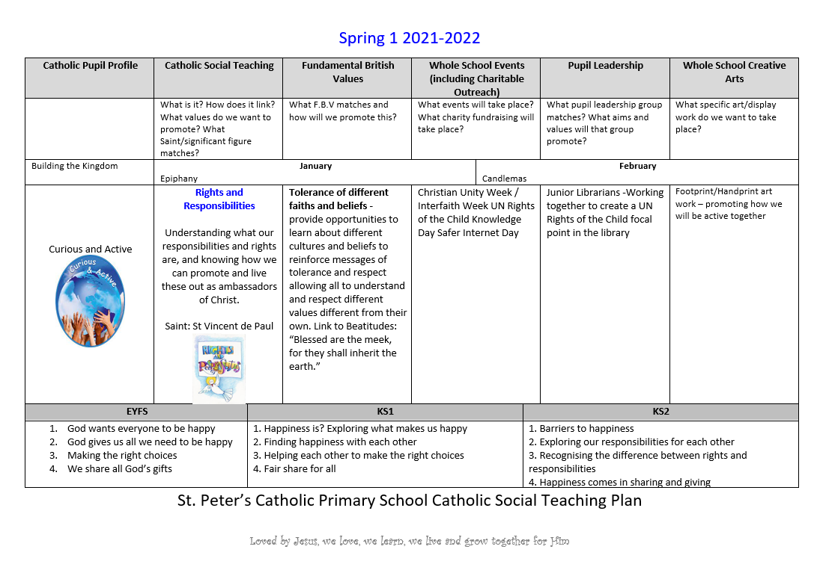
Catholic SOCIAL TEACHING MAP

Slide 16
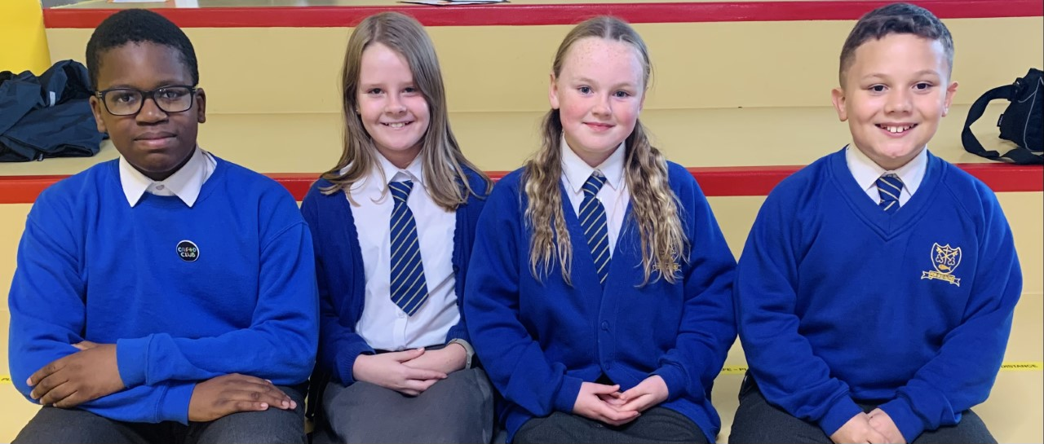
Together, We’re changing the world

